Slide 1




Consumer goods ad-hoc insights
SQL Project Challenge
Presented By – Madhu Sainani

Slide 2



AtliQ Hardware
Business Model:
AtliQ Hardware is a global supplier of hardware products, including PCs, network devices, storage solutions, and peripherals.
The company serve our diverse customer base through three primary channels: Retailers, Direct Sales, and Distributors.
Retailer
Channel
Direct
AtliQ Exclusive
AtliQ e store
Distributor
Neptune

Slide 3

Analysis Approach
Problem Statement:
Insufficient insights to make quick and smart data-driven decisions.
Data Visualization:
Used Power BI for making graphs based on various categories.
Insights:
Provided insights to top-level management, enabling them to make informed strategic decisions.
Task:
Utilize SQL Query to solve 15 Ad-hoc requests and create stored procedures for 5 requests.

Slide 4
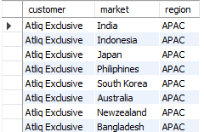


Request | Query | Output
#Task 1: Provide the list of markets in which customer “Atliq Exclusive” operates in business in APAC region.

Slide 5
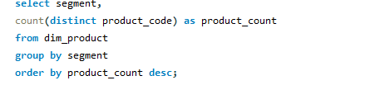
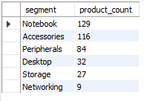
Request | Query | Output
#Task 2: Provide a report with all the unique product counts for each segment and sort them in descending order of product counts. The final output contains 2 fields: segment and product count.

Slide 6
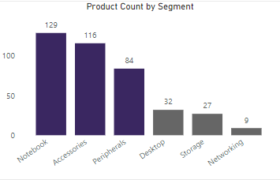
Visualization | Insights
INSIGHTS:
The “Notebook” segment has the highest product count, with 129 products.
The “Networking” segment has lowest product count, with 9 products.
Based on the analysis, notebooks and accessories are offering competitive advantage. Invest more in these areas by improving quality, or enhancing marketing efforts to capitalize on their strengths.
To avoid over-relying on notebooks and accessories, look for opportunities to grow in other areas like peripherals, desktops, storage, and networking.

Slide 7
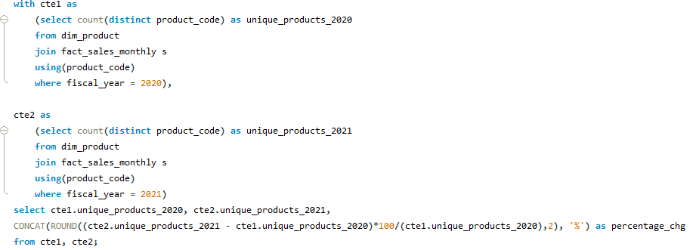
Request | Query
#Task 3: What is the percentage of unique product increase in 2021 vs. 2020? The final output contains these fields: unique_products_2020, unique_products_2021, percentage chg.

Slide 8

Output | Insights
INSIGHTS:
The unique product in FY 2020 -> 245
The unique product in FY 2021 -> 334
Product count increased by 36.33% compare to FY 2020, potentially leading to enhanced market presence and increased revenue opportunities.

Slide 9
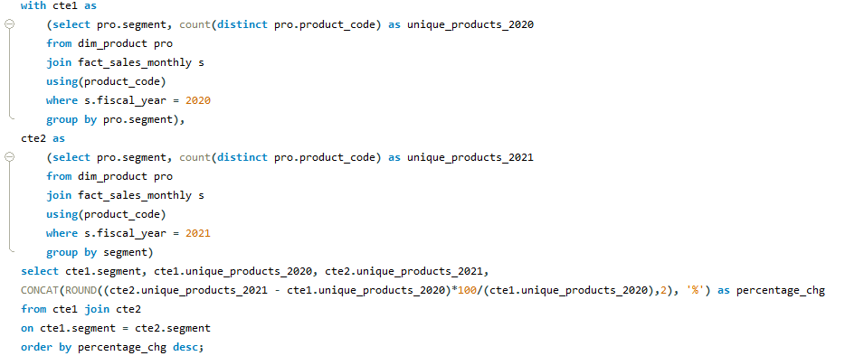
Request | Query
#Task 4: Which segment had the most increase in unique products in 2021 vs 2020? The final output contains these fields: segment, product_count_2020, product_count_2021,percentage chg.

Slide 10
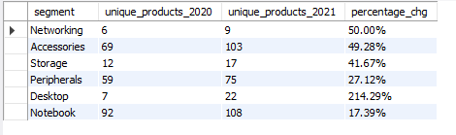
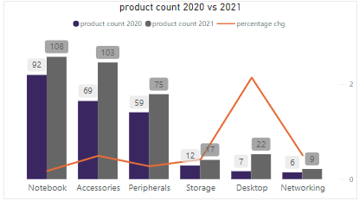
Output | Visualization | Insights
INSIGHTS:
The desktop segment had highest percentage change of 214.29%, with the product count increasing from 7 in FY 2020 to 22 FY 2021. While the Notebook segment had the lowest percentage change of 17.39%.

Slide 11
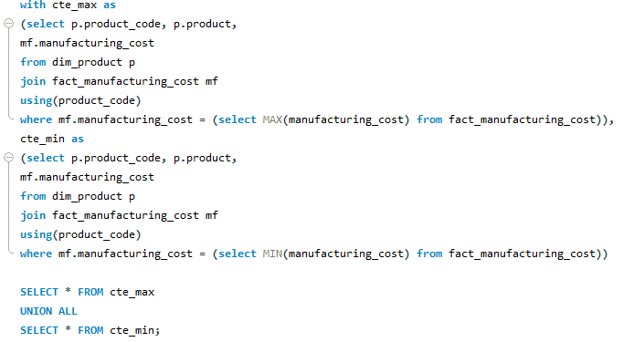

Request | Query | Output
Task 5: Get the products that have the highest and lowest manufacturing costs. The final output should contain these fields: product code, product, manufacturing cost.
AQ HOME Allin 1 Gen 2
$263.42
Personal Desktop
AQ Master wired x 1 Ms
$0.865
Mouse

Slide 12
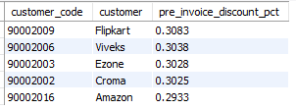
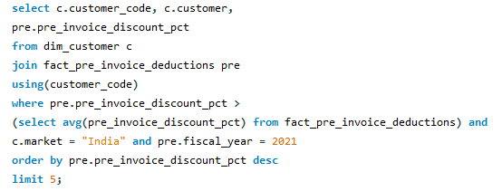
Request | Query | Output
# Task 6: Generate a report which contains the top 5 customers who received an average high pre invoice discount pct for the FY 2021 and in the Indian market. The final output contains these fields: customer code, customer, average discount percentage.

Slide 13
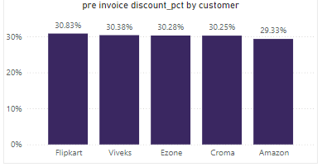
Visualization | Insight
INSIGHTS:
Flipkart offers highest pre invoice discount percentage of 30.83%, followed by Viveks, Ezone, Croma, and Amazon.
This indicates that Flipkart is leading in providing the most attractive pre-invoice discounts to customers.

Slide 14
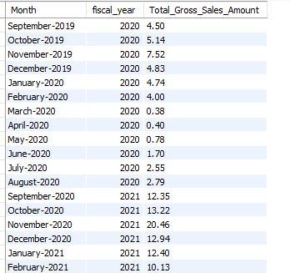
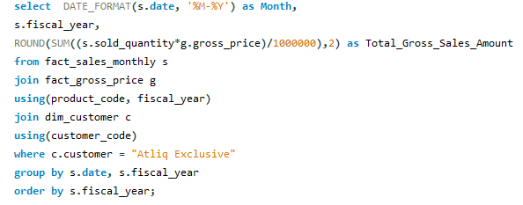
Request | Query | Output
# Task 7: Get the complete report of the Gross sales amount for the customer “Atliq Exclusive” for each month. This analysis helps to get an idea of low and high-performing months and take strategic decisions. The final report contains these columns: Month, Year, Gross sales Amount.

Slide 15

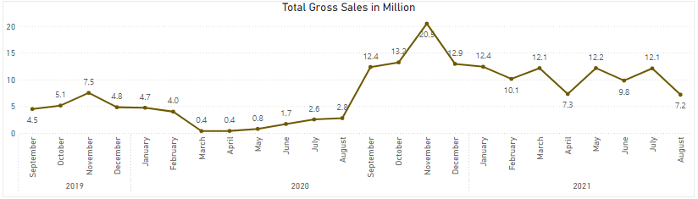

Visualization | Insights
Highest Sales Month : November (Diwali and Christmas Sales): $20.5M
Lowest Sales Month: March 2020 and April 2020 (COVID-19 Impact) : $0.4M

Slide 16
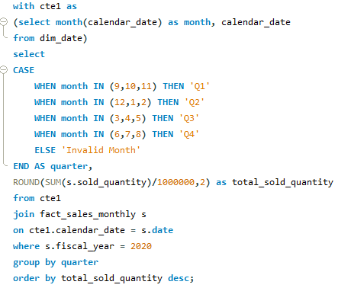
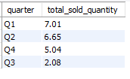
Request | Query | Output
#Task 8: In which quarter of 2021, got the maximum total sold quantity? The final output contains these fields sorted by the total sold quantity, Quarter, total sold quantity.
FY 2021

Slide 17
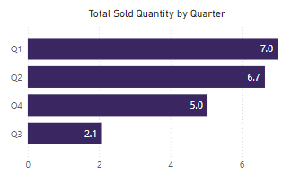
Visualization | Insights
FY 2020
INSIGHTS:
For AtliQ
Q1: September, October, November
Q2: December, January, February
Q3: March, April, May
Q4: June, July, August
Highest Sold Quantity: Q1, with $7M total sold quantity
Lowest sold quantity: Q3, with $2.1 total sold quantity
Quarter 3, encompassing March, April, and May, marked the peak of COVID-19 Impact for AtliQ.

Slide 18
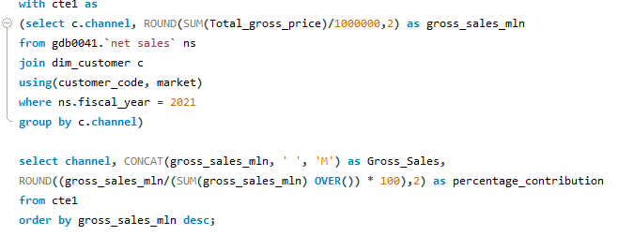

Request | Query | Output
#Task 9: Which channel helped to bring more gross sales in the fiscal year 2021 and the percentage of contribution? The final output contains these fields: channel, gross sales in million, percentage.

Slide 19
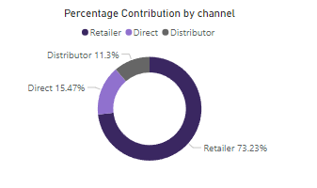
Visualization | Insights
INSIGHTS:
Retailer has highest contribution of 73.23%, with total gross sales of $1219.08M.
The remaining 26.77% of the contribution comes from Direct and Distributor channels, with total gross sales of $257.53M and $188.03M, respectively.

Slide 20
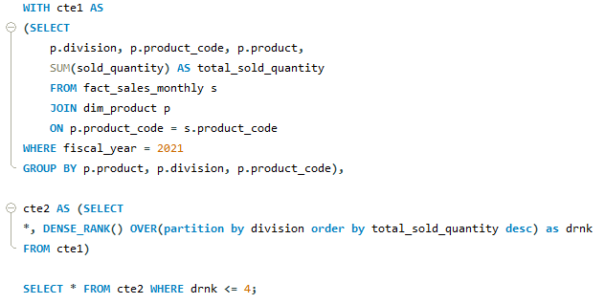
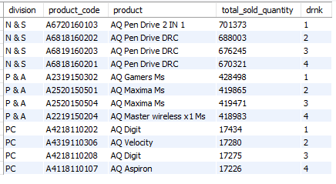
Request | Query | Output
#Task 10: Get the Top 4 products in each division that have a high total sold quantity in the fiscal year 2021?
The final output contains these fields: division, product code, product, total sold quantity, rank order.

Slide 21
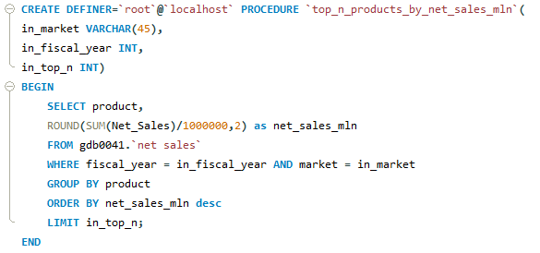
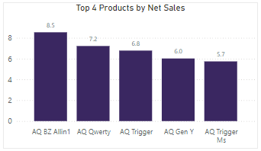
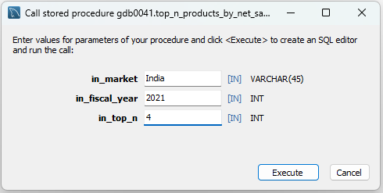
Request | Query | Output
#Task 11: Create the stored procedure for top N products by net sales in million and Market. The fields should include: product and net sales in million.
For Market = “India” and FY2021

Slide 22
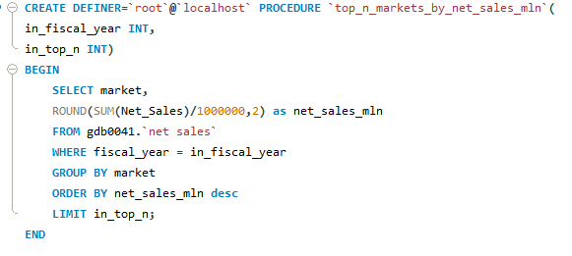
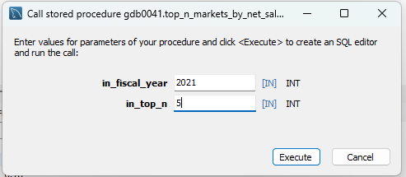
Request | Query
#Task 12: Create a stored procedure for Top N markets by net sales in million. The fields should include: market and net sales in million.

Slide 23
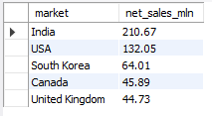
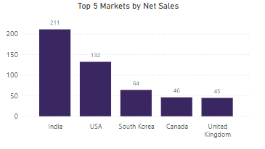
Visualization | Output
INSIGHTS:
India has the highest contribution to Net sales, with $211M followed by USA, South Korea, Canada, and UK, reflecting a diverse global market presence.

Slide 24
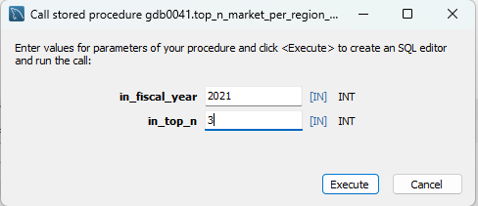
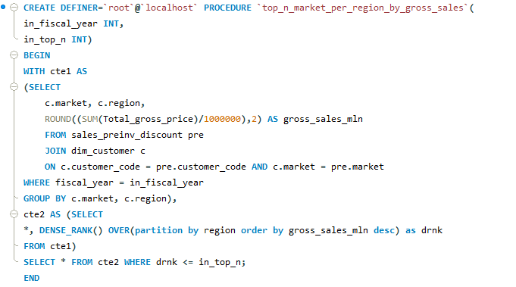
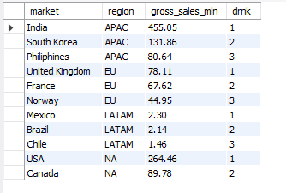
Request | Query | Output
#Task 13: Create the stored procedure for top N markets per region by gross sales. The field should include: market, region, gross sales in million, and rank.

Slide 25
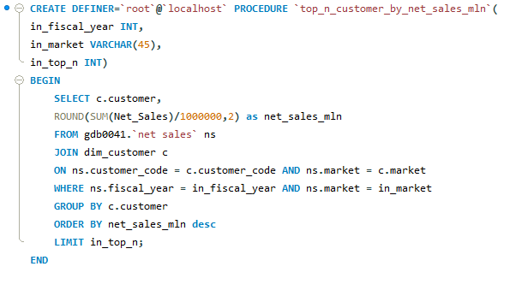
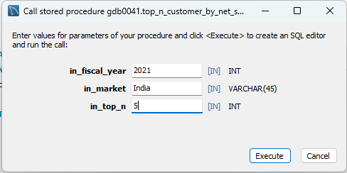
Request | Query
#Task 14: Create the stored procedure for top N customers by net sales in million. The field should include: customer and net sales in million.

Slide 26
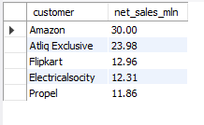
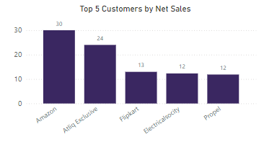
Output | Visualization
INSIGHTS
Amazon has the highest contribution to Net sales, with $30M followed by AtliQ Exclusive, Flipkart, Electricalsociety, and Propel.

Slide 27
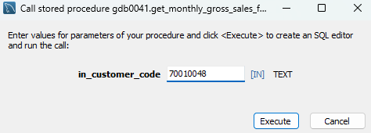
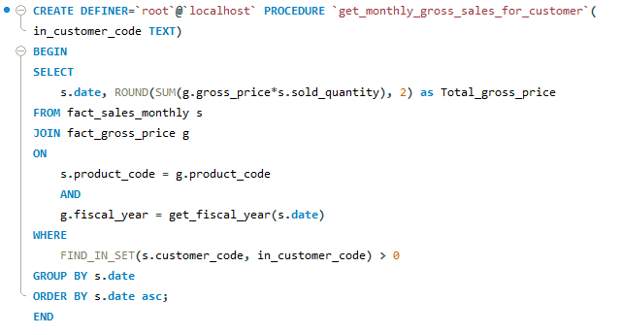
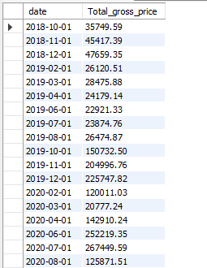
Request | Query | Output
#Task 15: Create a stored procedure to get monthly gross sales for a particular customer id.

